Slide 1
Practitioner-Centered Software Engineering
David Umphress

Slide 2
Software engineering is …
... the business of developing worthwhile solutions through software. [Umphress]
Our Vision
Notes:
Andrew Koenig notes that "software is hard to develop for many reasons: We must figure out what to do, do it, and ensure that we have done it correctly." [http://www.drdobbs.com/cpp/why-is-software-so-hard-to-develop/240168832].
The so-called "traditional" engineering fields (mechanical, civil, electrical, chemical) came into being for the very purpose of addressing the same issues. The difference is that the traditional engineering fields address building complex physical things instead of building software.
Just as electrical engineering is the business of developing worthwhile solutions through power systems and civil engineering is the business of developing worthwhile solutions through bridges and roads, software engineering can be defined in the same sense: software engineers are in the business of developing worthwhile solutions . . . they just happen to articulate those solutions in software instead of physical systems.

Slide 3
Cognitive activities involved
Envision
identifying a desired future state
Synthesize
determining how to reach the future state
Articulate
executing the steps to reach the future state
Interpret
ensuring the degree to which the future state has been achieved
Analysis
Design
Construct
Test
Notes:
The four fundamental activities of engineering are:
Envision: identifying a desired future state
Synthesize: determining how to reach that future state
Articulate: taking the actions necessary to reach the future state
Interpret: ensuring that the future state has been achieved
Applying these activities to software at a high level of abstraction, we have, respectively, analysis, design, construction, and test.
This is not suggesting that all these activities take place in sequence. In fact, how we order these activities, how much of each activity we perform. and how we carry out each activity determines to a great extent the quality of the software solution itself. Performing these activities in a seat-of-the-pants fashion gives us – and, more importantly our customers – little confidence that we have systematically come up with a good solution.
The term "software process" was coined to describe how and when engineering activities are carried out. The idea was initially exciting due to the parallels it draws to manufacturing processes used in industry to produce quality goods. Over the years, attempts to codify, measure, and enforce process cast a bureaucratic pall over the term, so much so that "software process" is eschewed by many developers because it smacks of attempts to overregulate an essentially creative endeavor.
The objective of Practitioner-Centered Software Engineering (PCSE) is to have individuals developers enact engineering activities at their own skill level, as opposed to dictating engineering activities in the traditional fashion. As such, PCSE is not a software process, but a framework for identifying an initial software process and modifying that process to meet specific, individual developer needs. PCSE, thus, views "process" not as prescriptive software development, but as a conscious recognition of the way in which to build software.

Slide 4
Cognitive activities involved - 2
E id goals, stakeholders
S talk with stakeholders
A document
I validate
E …
S …
A …
I …
E
S
A
I
E elicit
S analyze
A specify
I validate
id dev constraints
E
S
A
I
E analysis
S design
A construct
I test
id minimal activities
carry out dev
activities
practices
tune
What are the activities that need to be executed?
In what order?
How?
Notes:
The tenet engineering activities – envision, synthesize, articulate, and interpret – are abstract in the sense that they address the "what" of problem solving, they don't address how to go about carrying them out. This distinction is important. If an activity is carried out in a defined fashion, we refer to it as a "practice". Put simply: activities are abstract, practices are specific.
For example, suppose we are trying to determine the problem that is to be addressed with a software solution. We are in the "envision" activity, specifically performing requirements analysis. Absent any particular approach to conducting requirements analysis, we consider it an activity with no prescribed practice. If we don't feel comfortable that we know how to accomplish it, we break it down in engineering fashion: we envision, synthesize, articulate, and interpret requirements. In other words, we elicit requirements, analyze requirements, specify requirements, and validate requirements. If we have a specific way of carrying out, say, elicitation, we then say we have a practice for it and we need not define it any further. If we don't have a practice for it, we repeat the engineering process until we get to a level of granularity where we can identify a practice.
Given this concept, PCSE addresses the issues of
what activities need to be carried out
what practices are used to carry out activities
in what order is everything done
how well is everything being done
what activities and practices need to be changed during development to improve quality

Slide 5
Ingredients
Minimal Guiding Indicators
A statement of project goals and the means by which we know if we've achieved them.
Typically expressed in terms of cost, schedule, performance.
Minimally Viable Process
Orders MSAs so as to structure the effort to be as non-invasive as possible, yet provide enough structure to be viable.
Done by listing the lowest-level MSAs and determining work flow.
MEPs describe how MVAs will be carried out
Cost indicators
Get Rich
$ income > $ outgo
Minimally Effective Practice
Instructs developers in what to do.
Done by specifying lowest-level MSAs
MVP identifies the relationship of the MSAs
MSAs describe how objectives will be achieved
Minimally Sufficient Activity
The least possible set of conceptual lifecycle activities needed to produce software of a given quality.
Operational | Engineering | Business | Legal
MSA | MEP
Req Analysis
Design
Code
Test
Plan
Monitor
Market
Sell
Sue
MSA | MEP
Req Analysis | ad hoc
Design | Larman
Code | ad hoc
Test | Smoke
Plan | ad hoc
Monitor | ad hoc
Market | bill board
Sell | Google Play
Sue | ad hoc
Market
Market
Plan
Engineering
Envision
Req Analysis
Synthesize
Design
Articulate
Code
Interpret
Test
Operational
Plan
Monitor
Business
Market
Sell
Legal
Sue
Plan
Engineering
Envision
Req Analysis
Synthesize
Design
Articulate
Code
Interpret
Test
Operational
Plan
Monitor
Business
Market
Sell
Legal
Sue
Engineering
Envision
Req Analysis
Synthesize
Design
Articulate
Code
Interpret
Test
Operational
Plan
Monitor
Business
Market
Sell
Legal
Sue
Engineering
Envision
Req Analysis
Synthesize
Design
Articulate
Code
Interpret
Test
Operational
Plan
Monitor
Business
Market
Sell
Legal
Sue
Engineering
Envision
Req Analysis
Synthesize
Design
Articulate
Code
Interpret
Test
Operational
Plan
Monitor
Business
Market
Sell
Legal
Sue
Req Analysis
Req Analysis
Monitor
Monitor
Design
Design
Code
Code
Test
Test
Sue
Sell
Sue
Sell
Having identified this information, we have a basis for alleviating software development pain points.

Slide 6
Actual example
Minimal Guiding Indicators
Minimal Viable Process
Operational Engineering Business
Minimal Effective Practice
Goal | Indicator
Cost: | None
Schedule: | PV/EV >.75
Performance: Product: NFR: FR: Process: | latency < 3ms 100% BVA pain < value
MSA | MEP
Analyze | Scenarios
Architect | CRC
Plan Project | Component-based estimation
Plan Iteration | Component-iteration map
Construct | TDD
Review | Test code coverage
Refactor | ad hoc sniffing
Integrate | ad hoc
Repattern | ad hoc
Monitor/Cntrl | Burndown, PV/EV
Post Mortem | Backlog
Release | Eclipse zip, spreadsheets
Press Release | Blog posting
Analyze
Architect
next release
Plan Project
Plan Iteration
Construct
Review
Minimal Sufficient Activities
Engineering Activities
Envision
Analyze
Synthesize
Architect
Articulate
Construct
Refactor
Interpret
Review
Integrate
Repattern
Operational Activities
Plan
Plan project
Plan iteration
Monitor and Control
Business Activities
Market
Press release
inadequate
Refactor
Monitor/Cntrl
Integrate
incomplete
*
Repattern
Post Mortem
*
Release
Press release
* points at which MGIs are evaluated to shape product/process.
*

Slide 7
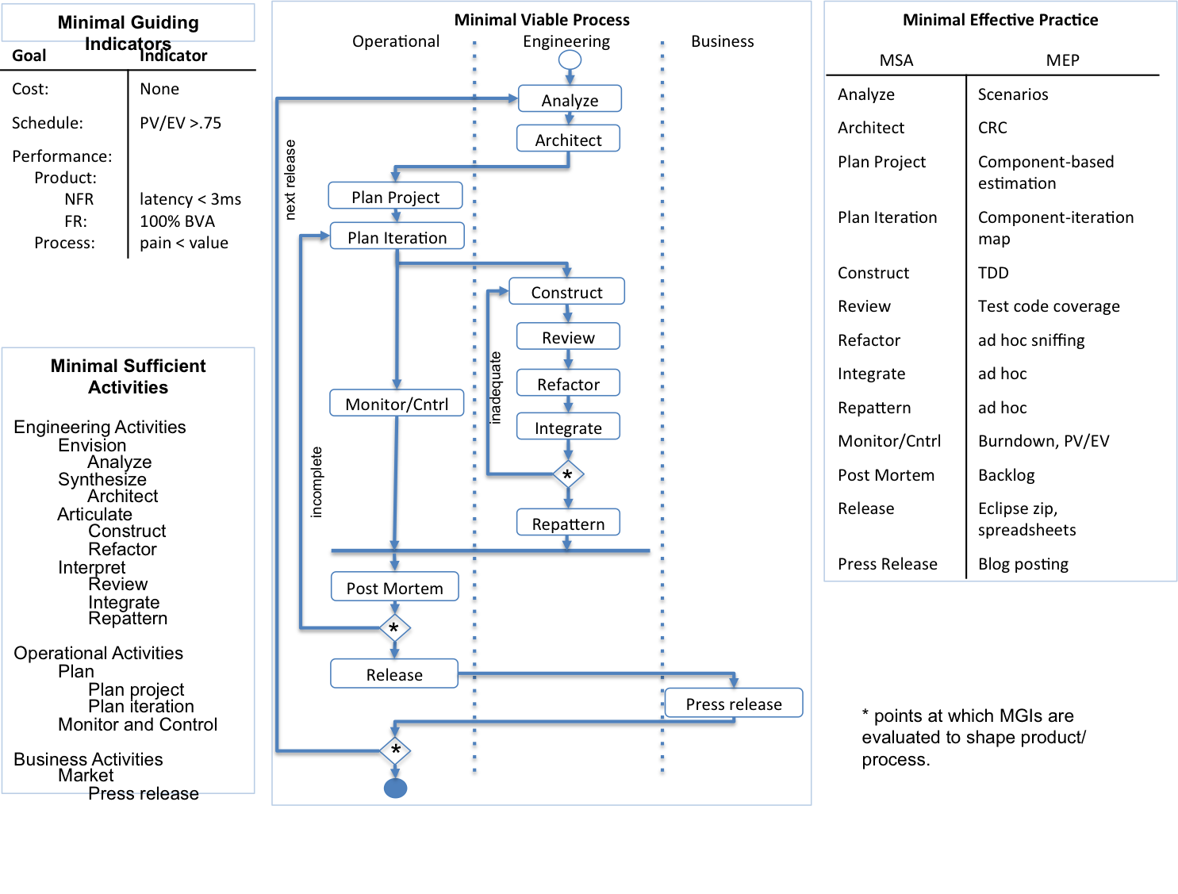
But … must allow for technology transition
(MGI + MSA + MVP + MEP)₁
subset that is palatable, but not viable
(MGI + MSA + MVP + MEP)₂
subset that is palatable, but not viable
. . .
(MGI + MSA + MVP + ME_{P)}n
. . .
pain
pain
pain
In an industrial setting, we may not necessarily know the goal process. We start with the status quo and tune according to practitioner needs – hence the name: Practitioner-Centered Software Engineering

Slide 8
Actual example – starting point
Minimal Guiding Indicators
Minimal Viable Process
Operational Engineering Business
Minimal Effective Practice
Goal | Indicator
Cost: | Don't care
Schedule: | submission date < due date
Performance: Product: NFR: FR: Process: | don't care don't care don't care
MSA | MEP
Analyze | ad hoc
Design | ad hoc
Code | ad hoc
Test | ad hoc
Analyze
Design
Code
Test
Minimal Sufficient Activities
Engineering Activities
Envision
Analyze
Synthesize
Design
Articulate
Code
Interpret
Test
Operational Activities
Monitor
Post mortem: What was your biggest pain points?
#1: bad grade due to errors found.
How can we alleviate this pain?
Strengthen Test MSA
Introduce testing practice as MEP

Slide 9
Actual example – cranking up the structure
Minimal Guiding Indicators
Minimal Viable Process
Operational Engineering Business
Minimal Effective Practice
Goal | Indicator
Cost: | Don't care
Schedule: | submission date < due date
Performance: Product: NFR: FR: Process: | don't care pass tests don't care
MSA | MEP
Analyze | ad hoc
Design | ad hoc
Code | ad hoc
Test | write acceptance test cases
Analyze
Design
Code
Test
Minimal Sufficient Activities
Engineering Activities
Envision
Analyze
Synthesize
Design
Articulate
Code
Interpret
Test
Operational Activities
Monitor
Post mortem: What was your biggest pain points?
#1: bad grade due to errors found.
#2: didn't have enough time.
How can we alleviate this pains?
Further strengthen Test MSA
Add visibility into effort

Slide 10
Actual example – cranking again
Minimal Guiding Indicators
Minimal Viable Process
Operational Engineering Business
Minimal Effective Practice
Goal | Indicator
Cost: | Don't care
Schedule: | submission date < due date
Performance: Product: NFR: FR: Process: | don't care pass tests time-in-activity accurate to 15 min granularity
MSA | MEP
Analyze | ad hoc
Design | ad hoc
Code | ad hoc
Test | write acceptance test cases with defined level of coverage
Monitor | Record time spent in each activity
Analyze
Design
Code
Test
Minimal Sufficient Activities
Engineering Activities
Envision
Analyze
Synthesize
Design
Articulate
Code
Interpret
Test
Operational Activities
Monitor
Post mortem: What was your biggest pain points?
And so forth until goal process is achieved
The pace of process change increments depends on available time, student skill level, acceptance rate.

Slide 11
Actual example – the goal
Minimal Guiding Indicators
Minimal Viable Process
Operational Engineering Business
Minimal Effective Practice
Goal | Indicator
Cost: | None
Schedule: | PV/EV >.75
Performance: Product: NFR: FR: Process: | latency < 3ms 100% BVA pain < value
MSA | MEP
Analyze | Scenarios
Architect | CRC
Plan Project | Component-based estimation
Plan Iteration | Component-iteration map
Construct | TDD
Review | Test code coverage
Refactor | ad hoc sniffing
Integrate | ad hoc
Repattern | ad hoc
Monitor/Cntrl | Burndown, PV/EV
Post Mortem | Backlog
Release | Eclipse zip, spreadsheets
Press Release | Blog posting
Analyze
Architect
next release
Plan Project
Plan Iteration
Construct
Review
Minimal Sufficient Activities
Engineering Activities
Envision
Analyze
Synthesize
Architect
Articulate
Construct
Refactor
Interpret
Review
Integrate
Repattern
Operational Activities
Plan
Plan project
Plan iteration
Monitor and Control
Business Activities
Market
Press release
inadequate
Refactor
Monitor/Cntrl
Integrate
incomplete
*
Repattern
Post Mortem
*
Release
Press release
* points at which MGIs are evaluated to shape product/process.
*

Slide 12
Credits
PCSE Team
Asmae Mesbahi El Aouame
Brad Dennis
Haneen Alabdulrazzaq
Jake O'Dowd
Matt Hardwick
Matt Swann
Russell Thackston
Susan Hammond
Taha Al Tekreeti
Yasmeen Rawajfih
Neda Topuz
Eric Shaw
Andrew Marshall
Raj Swamidurai
Neda Topuz

Slide 13
BACKUP

Slide 14
Minimal Guiding Indicators
Minimal Viable Process
Operational Engineering Other
Minimal Effective Practice
Goal | Indicator
Cost:
Schedule:
Performance: Product: NFR: FR: Process:
MSA | MEP
Minimal Sufficient Activities
Engineering Activities
Envision
Synthesize
Articulate
Interpret
Operational Activities
Plan
Monitor and Control
Customer Relations

